Slide 1


Slide 2


Slide 3

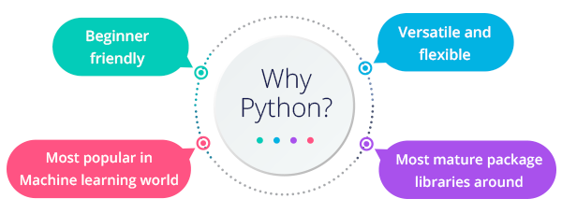
python

Slide 4
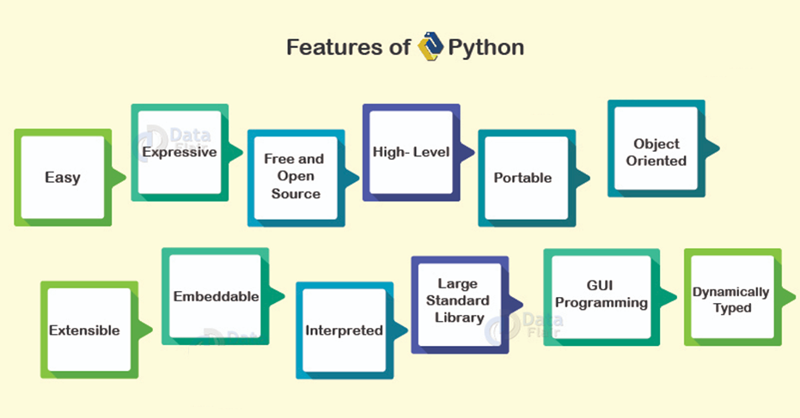
python

Slide 5
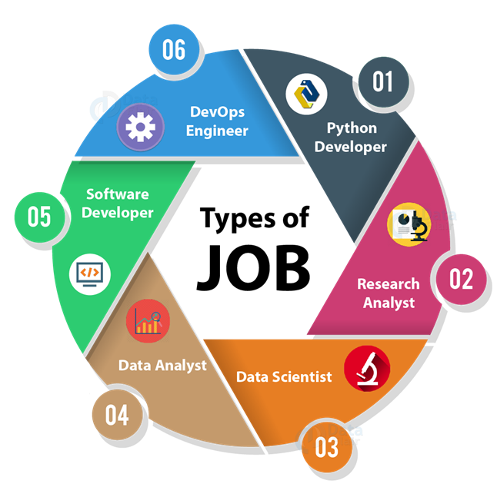
python

Slide 6
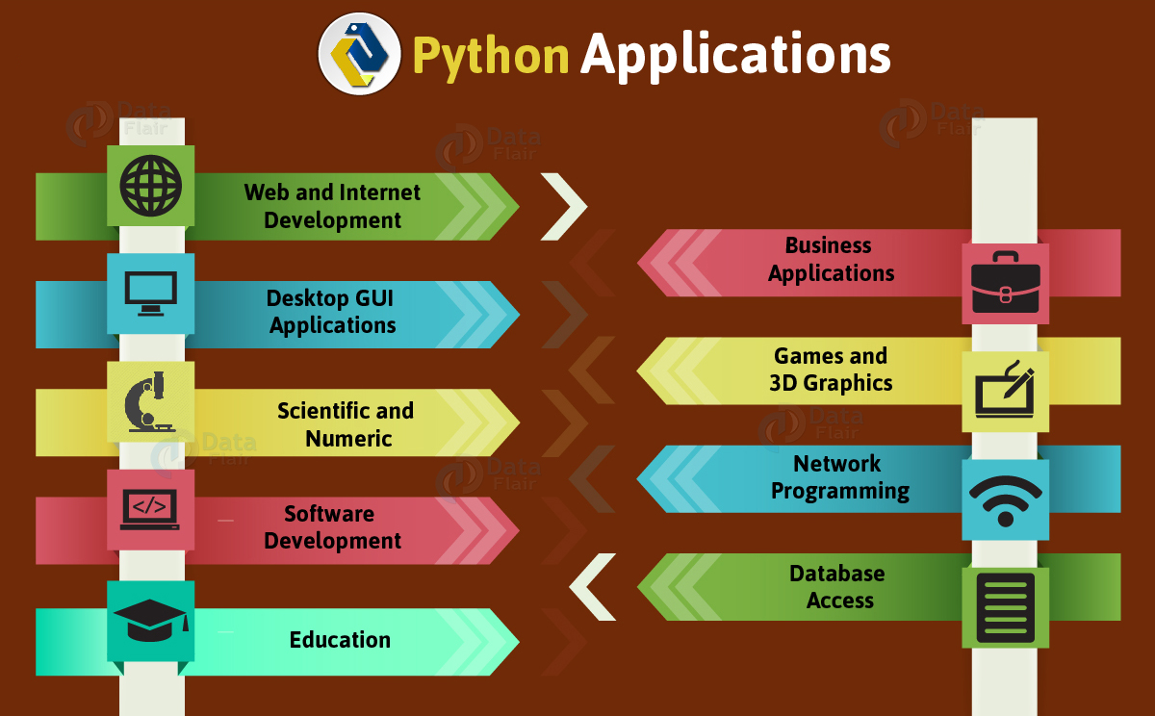

Slide 7
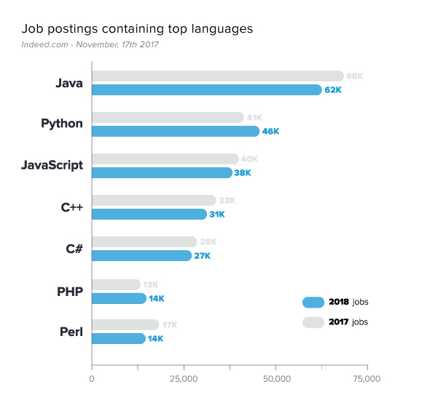
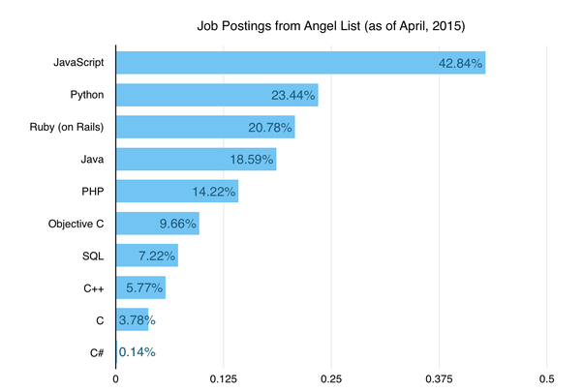
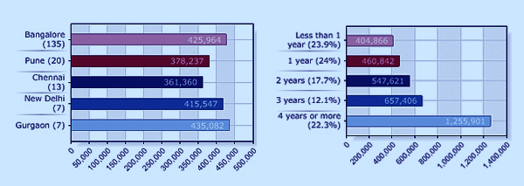
python salary

Slide 8
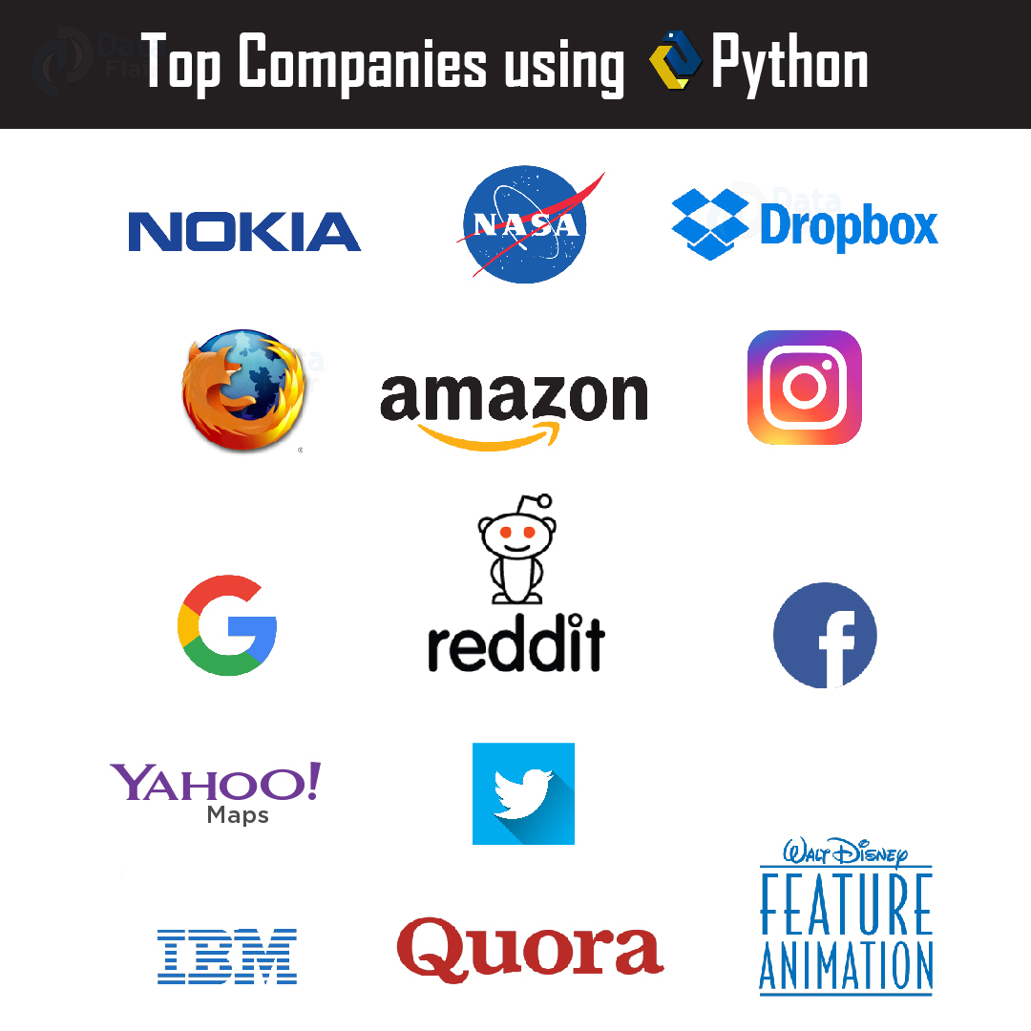

Slide 9
python
Simple
Python is a simple and minimalistic language in nature
Reading a good python program should be like reading English
Its Pseudo-code nature allows one to concentrate on the problem rather than the language
Easy to Learn
Free & Open source
Freely distributed and Open source
Maintained by the Python community
High Level Language –memory management
Portable – *runs on anything c code will

Slide 10
python
Interpreted
You run the program straight from the source code.
Python program →Bytecode →a platforms native language
You can just copy over your code to another system and it will auto-magically work! *with python platform
Object-Oriented
Simple and additionally supports procedural programming
Extensible – easily import other code
Embeddable –easily place your code in non-python programs
Extensive libraries

Slide 11
